Slide 1

VIT BHOPAL UNIVERSITY
DATE – 8/12/2021
SCHOOL OF ELECTRICAL & ELECTRONICS ENGINEERING
B .Tech. Topic-Approval & Progress Presentation On
AC POWER CONTROLLER WITH PROGRAMMABLE INTERFACE

Slide 2
CREDITS:
PRESENTED BY:
NAME: REG.NO.
YASH CHANDAK - 20BAC10026
ANIKET VERMA - 20BAC10042
AARTI ANJAR - 20BAC10027
Guided by - DR.NARENDRA BABU

Slide 3
Content of this Project:
Introduction
Findings
Objective
Proposed Methodology
Circuit Diagram
List of Components /Software /Tools used
Expected Outcomes
Conclusion
References

Slide 4
INTRODUCTION:
One can enter the required percentage of power supply through a keypad. The input is provided to a microcontroller
of 8051 family that initiate the firing angle to adjust the load power. For matching the power to the required one,
mechanism of the lamp. This system overcomes the faults in the present system and provides a solution for light illumination control
This system is built by using an 8051 microcontroller and based on the principle of firing angle control of
thyristors, which in turn can control the illumination of lamp. An LCD display unit is used, which displays entered percentage of the illumination through a matrix keypad.
The firing angle control of thyristors is done by the microcontroller, according to the desired percentage
entered by the user. Based on this input the microcontroller will automatically adjust the power delivered to the lamp through a solid state switching mechanism.

Slide 5
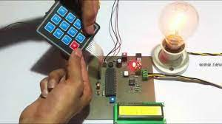
FINDINGS

Slide 6
OBJECTIVE:
The main objective of this work is to vary the percentage of power supply by means of phase angle variation of the conduction period through the setting of different firing times corresponds of different firing angles.
At the end of the work we will able to :-
Have the full understanding of firing angle.
Understand the application of TRIAC and SCR in power electronics.

Slide 7
METHODOLOGY:
Ac power control with thyristor usinig microcontroller is designed to control AC power flow across load .
This project is designed using AT85s52 microcontroller and zero crossing detection circuit
Phase angle control method is used for AC power control with thyristor .
Thyristor is used as a switch to control flow of power
AT85s52 microcontroller is usd to detect zero crossing and to generate pulse signals at a specific angle for thyristors .

Slide 8
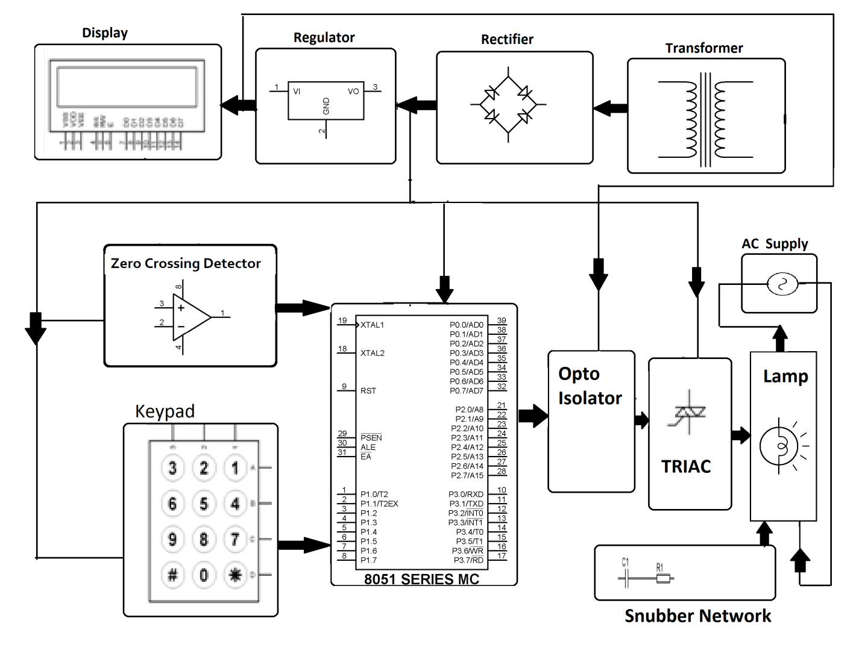
BLOCK DIAGRAM:

Slide 9
List of Components /Software
Software Specifications
Keil µVision IDE
MC Programming Language:
Embedded C
Hardware Specifications
8051 series Microcontroller
Transformer
LCD
Diodes
keypad
TRIAC
Opto Isolator
Lamp

Slide 10
Progress post review 1:
From the progress we have made in the project till now, we believe that the model can accurately recognize intensity of lamp to a given power.

Slide 11
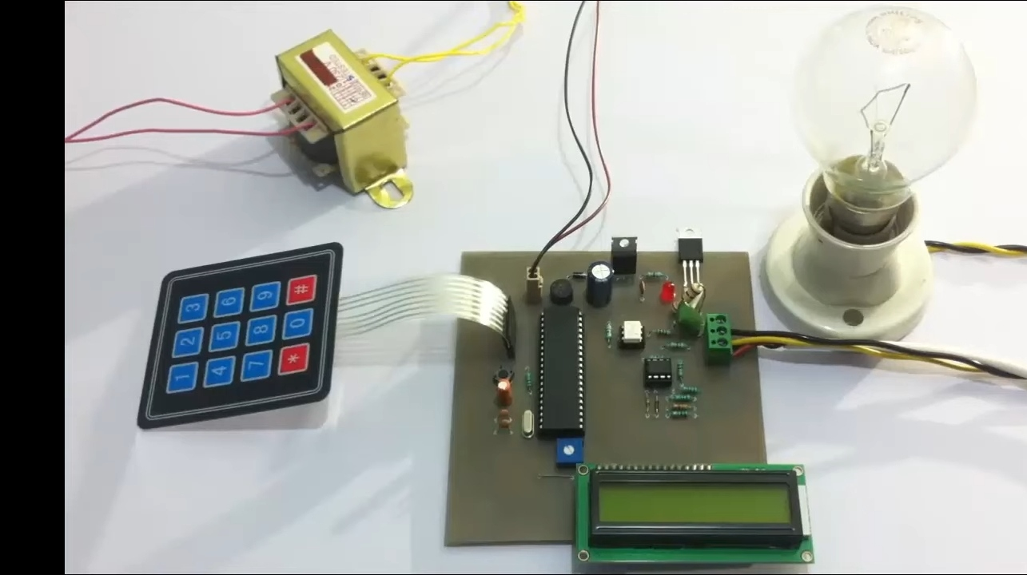
Here are the images of the model we have been working on.
Lets put on the switch and press *

Slide 12
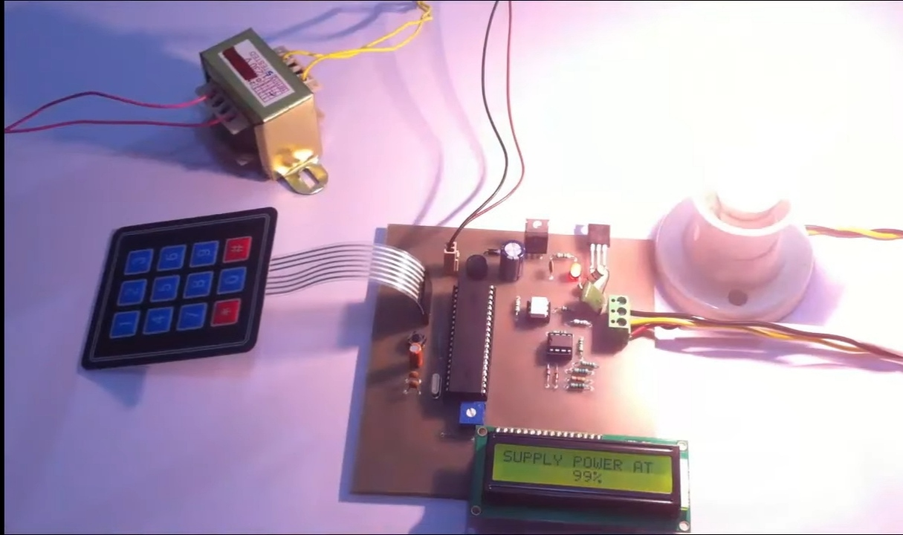
Lets put 99% of the intensity and see the intensity of light

Slide 13
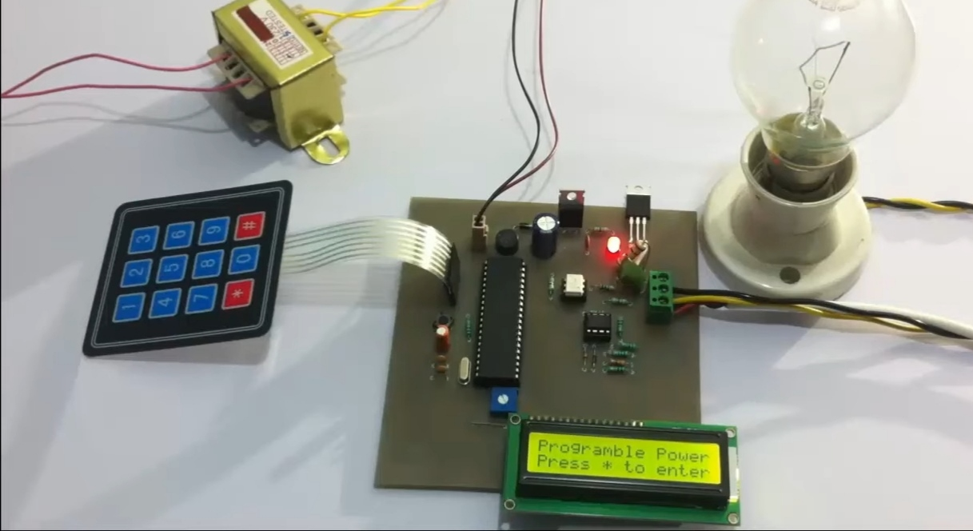
First we have to press * to enter the required percentage of intensity of light.

Slide 14
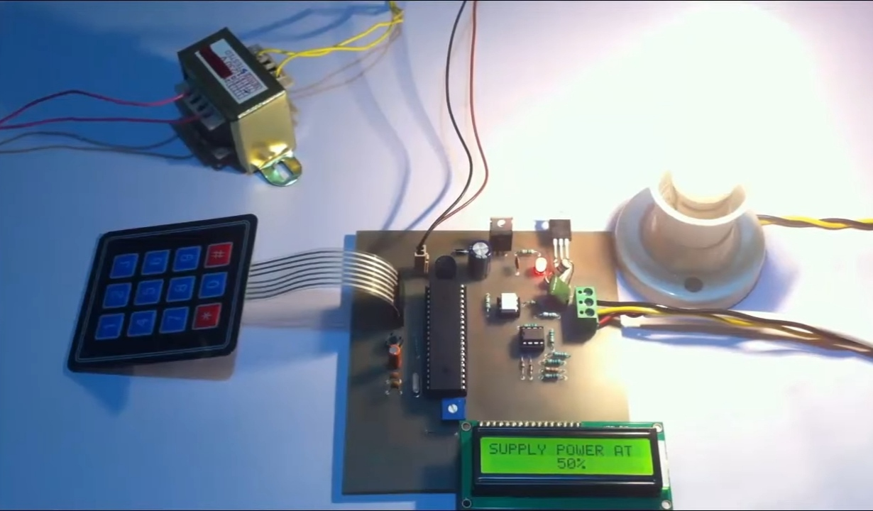
Lets say we input * and change the required percentage.
Lets say 50 % power.

Slide 15
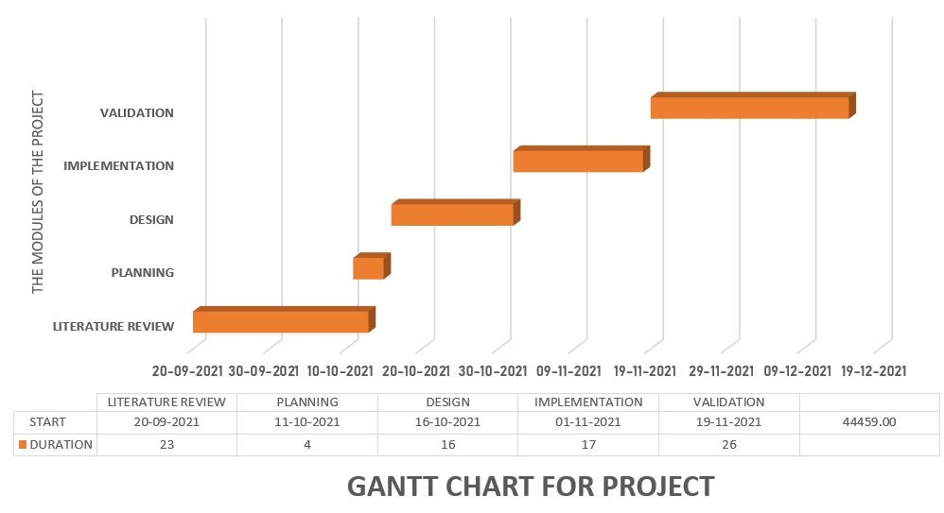
Gant chart representation of the work plan
Review 1
Review 2

Slide 16
As mentioned earlier, our trained model is ready and is working successfully. As for what's next, We are figuring out a plan to input a video and the model must be able to detect all the traffic signs and give relevant output with respect to that. The work done till now has all been a smooth sail right from downloading the data set to training the mode, however we were successfully able to eradicate the errors and bugs in the project that we had written till now.
Our next plan and work till now:

Slide 17
EXPECTED OUTCOME
The work is on contolling the AC power by using the concept of firing angle control of thyristors .
One can enter the required percentage of power supply through a keypad .
The input is provided to a miocrocontroller of 8051 family that initiate the firing angle to adjust the load power .
For matching the power to the required one, aTRIAC is used in series with the AC load .
A LCD screen is used to display the power percentage that is provided by the user

Slide 18
CONCLUTION:
This work is used at controlling the AC power by using the concept of firing angle control of thyristors.
With this device one can enter the required percentage of power supply through a keypad.

Slide 19
REFERENCE
Lee Siang Tat, YiauwKahHaur “AC Power Controller By Using Microcontroller”. ISSN:2180-1843 eISSN:2289-8131.Vol.8 No.12.
David Margulies, Clifford E. Felder, Galina Melman and Abraham Shanzer “A Molecular Keypad Lock: A Photochemical Device Capable Of Authorizing Password Entries”. Cite This:J.Am.Chem.Soc.2007,129,2 347-354 Publication date: December 19,2006.https://doi.org/10.1021/ja065317z.
Web ProForum Tutorials, “Global System for Mobile Communication (GSM)”, The International Engineering Consortium, http:// www.iec.org.com USA.
Gunnar Heine, “GSM Networks: Protocols, Terminology, and Implementation”, British Library, ISBN:0-89006-471-7, London, 1999.

Slide 20
Thanks

